Slide 1





Graph-Based Reasoning over Heterogenous External Knowledge for Commonsense Question Answering
Shangwen Lv^{1*}, Daya Guo^{2*}, Jingjing Xu^{3*}, Duyu Tang⁴, Nan Duan⁴, Ming Gong⁴,
Linjun Shou⁴, Daxin Jiang⁴, Guihong Cao⁴, Songlin Hu¹
¹Institute of Information Engineering, Chinese Academy of Sciences
²Sun Yat-sen University ³Peking University ⁴Microsoft Corporation
Notes:
Hi everyone, I am Shangwen Lv from Institute of Information Engineering, Chinese Academy of Sciences. Due to the coronavirus outbreak in China, I am not able to attend the conference and record the video.
My paper title is “Graph-Based Reasoning over Heterogenous External Knowledge for Commonsense Question Answering” .
This is a joint work with Daya Guo and Jingjing Xu.

Slide 2
Contents
Problem Definition
Related Work
Motivation
Framework Overview
Experiments & Analyses
Conclusion
Notes:
I will introduce our work as follows: I will first give the problem and then introduce some related works. We will then give an example to show our motivation and propose a framework to tackle the problem. Then, we will give some experiment results and analyses. Finally, we will give the conclusion.

Slide 3
Problem Definition
Given a question in our everyday life and several choices, we aim to select one choice that answers the question best.
Question: What do people typically do while playing guitar?
Choices: A. cry B. hear sounds C. singing D. anthritis E. making music
Notes:
The commonsense question answering problem aims to answer questions about everyday life. When dealing with these problems, we need to utilize our background knowledge and perform reasoning to make inferences.
One of the question format is multiple-choice format. Given a question and several choices, the goal is to select one choice that answers the question best.

Slide 4
Related Work
Utilize pre-trained models such as BERT, RoBERTa, etc.
Fine-tune pre-trained models on commonsense corpus like OMCS, and then fine-tune models on the target task.
Question+ Choice
Pre-trained Models
Choice
Score
Question+ Choice
Fine-tuned Models
Choice
Score
Pre-trained Models + Commonsense Corpus
Notes:
There are many related works aiming to tackle this problem. We classify them into four categories.
The first category is utilizing pre-trained models such as BERT, RoBERTa to get representations of input and get scores for each choice.
The second category tries to fine-tune pre-trained models on commonsense corpus like OMCS, and then fine-tune models on the target task.

Slide 5
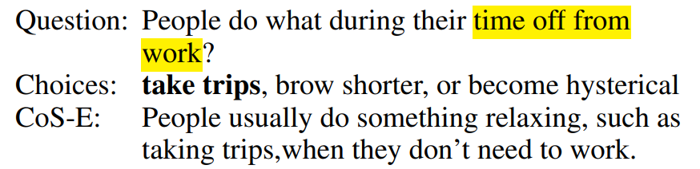
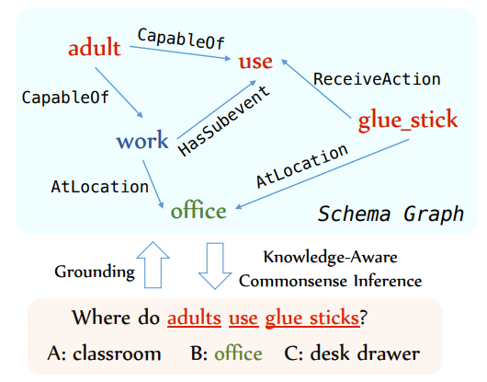
Related Work
Add human-annotated evidence to explain the answer^{[1]} (Cos-E)
Add evidence from structural knowledge like ConceptNet^{[2]} or unstructured knowledge Wikipedia
[1] Explain Yourself! Leveraging Language Models for Commonsense Reasoning. ACL 2019. Nazneen Fatema Rajani Bryan McCann Caiming Xiong Richard Socher
[2] KagNet: Knowledge-Aware Graph Networks for Commonsense Reasoning. EMNLP 2019. Bill Yuchen Lin, Xinyue Chen, Jamin Chen, Xiang Ren
Notes:
The third category tries to add external knowledge to explain the process we select the right answer. For the given question and right choice, the reason why we select the choice is given by humans. This method is time-consuming and hard to scale to other problems.
The last category tries to add structural knowledge like ConceptNet or unstructured knowledge Wikipedia to help resolve the problem. For example, KagNet in EMNLP 2019 tries to extract sub-graph from ConceptNet and utilize the path in the graph to make inferences.

Slide 6
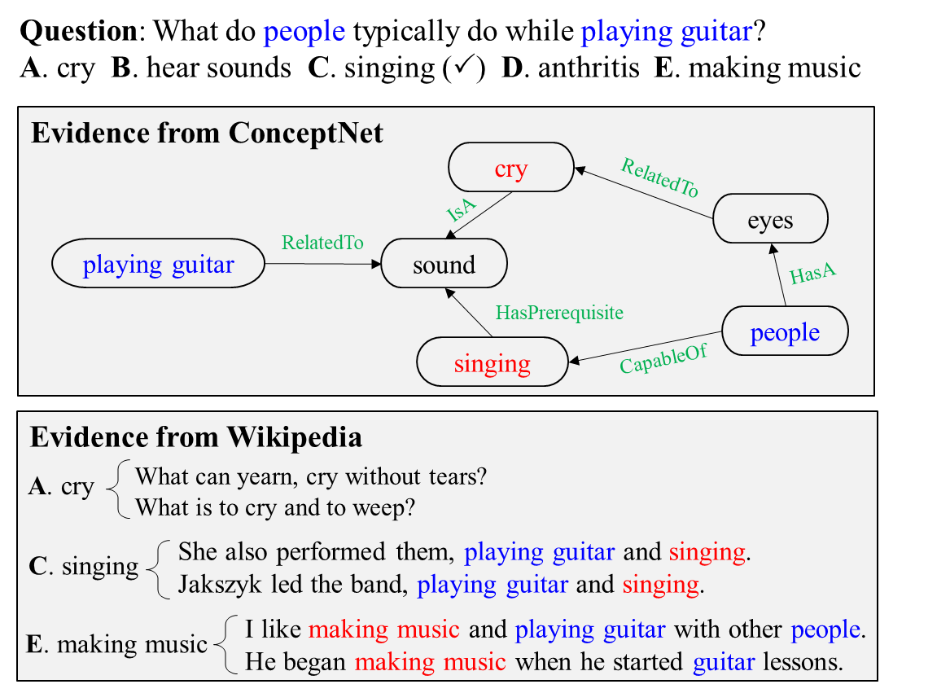
Motivation
Motivation
Heterogeneous knowledge sources are necessary for commonsense question answering
Utilize the structural and unstructured information of both sources
A、C
C
C、E
Notes:
Motivated by the former works, we observe that heterogeneous knowledge sources are both necessary for commonsense question answering. Structural knowledge are in high quality and unstructured knowledge have a high coverage. We will give one example to show why we should use both sources.
The question is “What do people typically do while playing guitar?” The words in blue are entities in the question and the words in red are the choices. From the evidence in ConcepNet, we can see that we can easily pick out choices “cry” and “singing”. But we can’t decide which one is correct. From the evidence in Wikipedia, we can select the choices “singing” and “making music”, but we can’t decide the answer either. By combing the knowledge from ConceptNet and Wikipedia, we can pick out the right answer “singing”. In this example, both knowledge can be helpful and combine them will help pick out the right answer.
In order to utilize the information of both sources, we utilize the structural and unstructured information of both sources by constructing graphs. And then we will utilize the graph to help enhance text representations. We will give more explanations in our following slides.

Slide 7



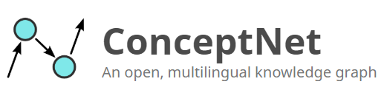
Framework Overview
Knowledge Extraction
Extract knowledge from structured knowledge like ConceptNet and unstructured knowledge like Wikipedia.
Graph-Based Reasoning
Construct graphs for both knowledge and reason over the graphs to infer final answers.
Output
Graph-Based Reasoning
Knowledge Extraction
Question + Choice
Notes:
As shown in the figure, our framework is composed of two parts: knowledge extraction and graph-based reasoning.
In the knowledge extraction part, we extract knowledge from structured knowledge like ConceptNet and unstructured knowledge like Wikipeida.
In the graph-based reasoning part, we construct graphs for both knowledge sources and perform reasoning over the graphs to infer final answers.

Slide 8
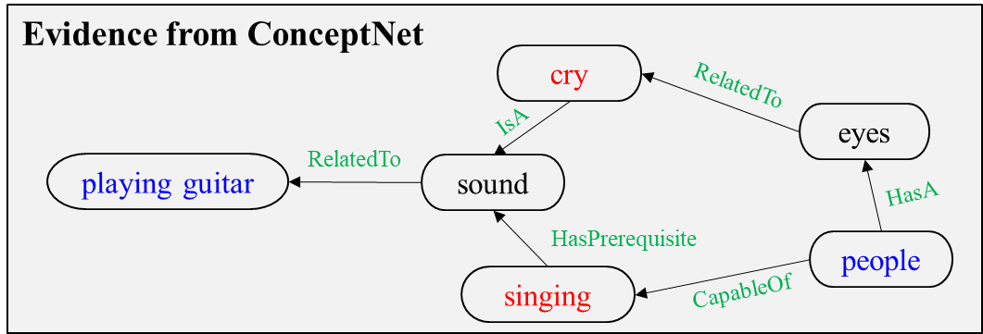
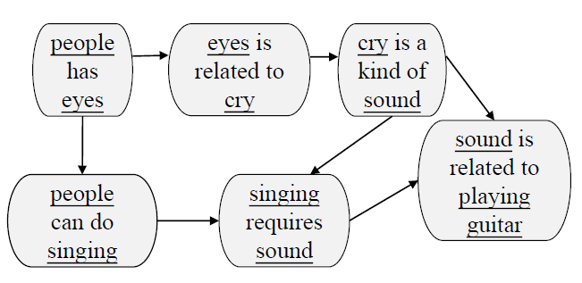
Knowledge Extraction
ConceptNet Evidence
Extract entities in question and choice, extract the paths from question entity and choice entity in ConceptNet (less than 3 hops).
Construct graphs to represent the evidence (Concept-Graph)
Each triple in ConceptNet is a node in the constructed graph and will be converted to natural language according to relation templates. If they two nodes have the same entity, there will be an edge between them. (We aim to utilize pre-trained models to get node representation)
ConceptNet
Concept-Graph
Notes:
Let’s first see how we retrieve knowledge from both sources. For ConceptNet, we first extract entities (or concepts) from question and choice, then we extract the paths from question entity and choice entity in ConceptNet. In the experiments, we restrict the paths less than 3 hops. Then we construct a graph rather than use the origin ConceptNet graph and call it Concept-Graph. Each triple in ConceptNet is a node in the new graph and will be converted to natural language sentences according to relation templates. For two nodes, if they have the same entity, we will add an edge between them. The reason why we construct a new graph is that we would like to utilize the pre-trained models to get the node representation.
Below is an example showing how we convert the origin graph to the constructed graph. The underlined words in Concept-Graph are the entities in ConceptNet.

Slide 9
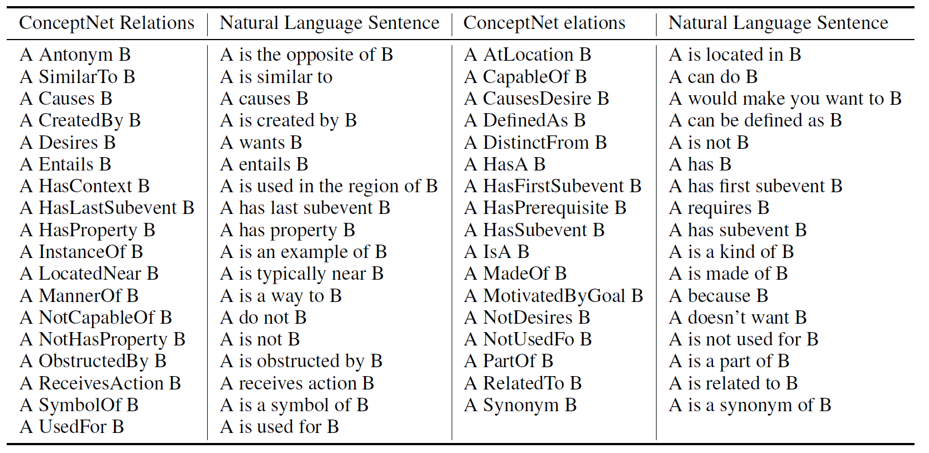
Knowledge Extraction
ConceptNet Relation Templates
Notes:
ConceptNet provides the detailed templates. We show that details in the table. The first and third columns are the origin relations. The second and last column are the corresponding natural language sentences.

Slide 10
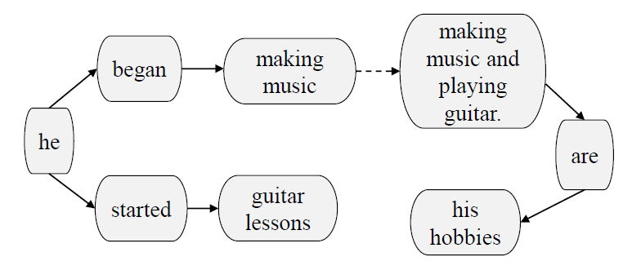
Knowledge Extraction
Wikipedia Evidence
Extract 107M sentences from Wikipedia by Spacy and adopt Elastic Search tools to index the Wikipedia sentences
Select top K sentences from the whole Wikipedia
Construct graphs to represent the structural information (Wiki-Graph)
Adopt Semantic Role Labeling (SRL) to extract predicates and arguments for each sentence. Predicates and arguments are nodes. The relations between predicates and arguments are the edges in the graph.
Making music and playing guitar are his hobbies.
He began making music when he started guitar lessons
Wikipedia evidence
Wiki-Graph
Notes:
For the Wikipedia evidence. We first extract 107M sentences from Wikipedia by Spacy and adopt Elastic Search to index all the sentences.
For each question and choice, we select top K sentences from the whole Wikipedia. We then construct graphs for these sentences to utilize the structural information and call it Wiki-Graph. We utilize Semantic Role Labeling tools to extract predicates and arguments for each sentence. Each predicate and argument will be a node in the graph. The relations between predicates and arguments are the edges in the graph. Specifically, an edge from the subject to predicate, and an edge from the predicate to object.

Slide 11
Graph-based Reasoning
Baseline
score
<cls>
Pre-trained Language Model ( BERT, XLNet, RoBERTa)
<sep>
Wikipedia Evidence
<sep>
ConceptNet Evidence
Question + Choice
Notes:
Next, we will introduce the graph-based reasoning part.
Our baseline is shown in the figure. We concatenate ConceptNet evidence, Wikipedia Evidence, Question and Choice, then utilize XLNet to get the representation and adopt the representation of CLS to get a score for each choice. Finally, we select the choice with the highest score as the predicted answer.

Slide 12
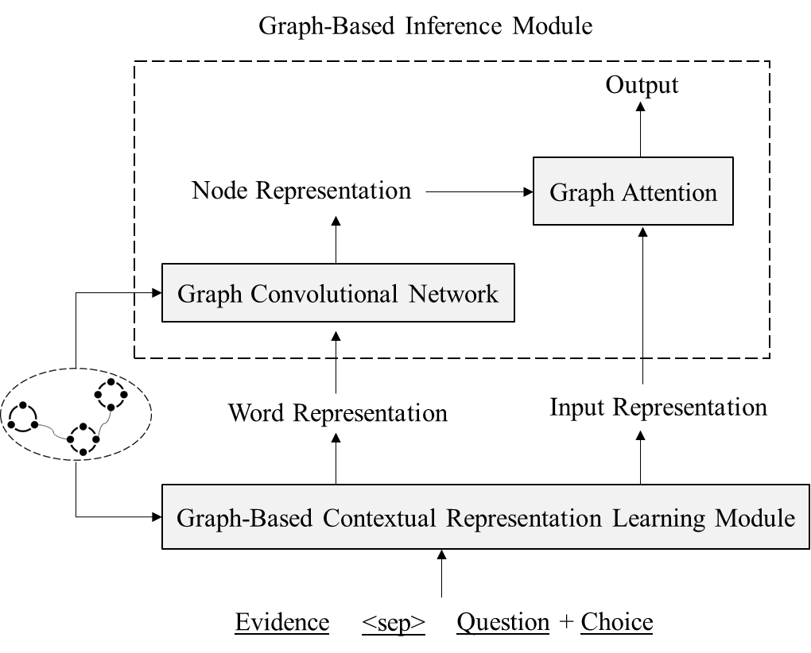
Graph-based Reasoning
Graph-based Contextual Representation Learning Module
Re-order the evidence sentences to re-define the distance between words.
Graph-based Inference Module
Utilize graph convolutional networks to obtain node representations
Adopt graph attention to aggregate nodes to infer final answers
Notes:
In the graph-based reasoning part. We propose two reasoning modules. Graph-based Contextual Representation Learning module to reorder the evidence to re-define the distance between words , and a graph-based inference module which first utilizes GCN to obtain node representations, and then adopts graph attention to aggregate nodes to infer final answers.

Slide 13
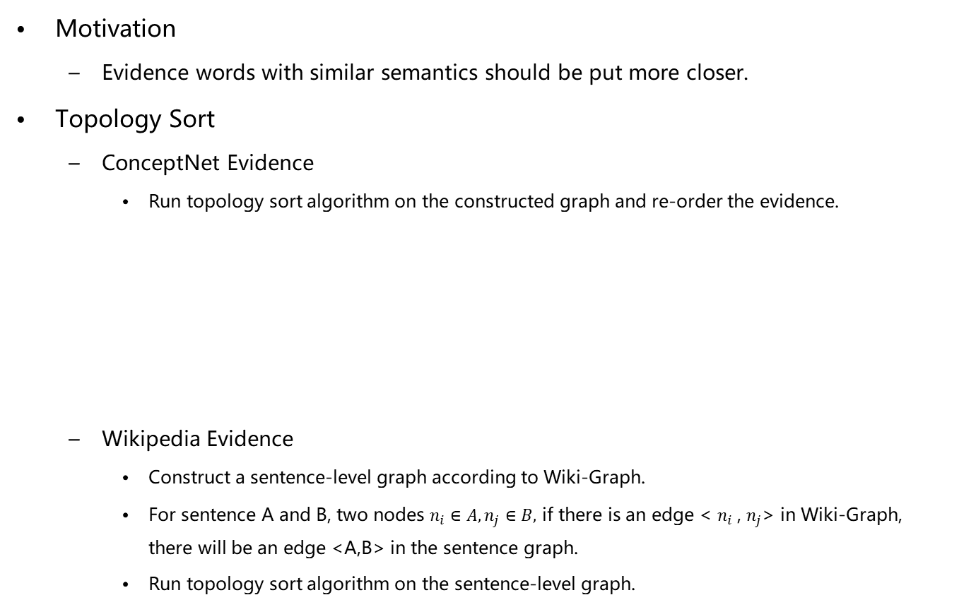
Graph-based Contextual Representation Learning Module
Motivation
Evidence words with similar semantics should be put more closer.
Topology Sort
ConceptNet Evidence
Run topology sort algorithm on the constructed graph and re-order the evidence.
Wikipedia Evidence
Construct a sentence-level graph according to Wiki-Graph.
For sentence A and B, two nodes $n_{i}∈A,n_{j}∈B,$ if there is an edge < $n_{i}$, $n_{j}$> in Wiki-Graph, there will be an edge <A,B> in the sentence graph.
Run topology sort algorithm on the sentence-level graph.
<“people has eyes”, “eyes is related to cry”, “people can do singing”, “cry is a kind of sound”, “singing requires sound”, “sound is related to playing guitar”>
Notes:
In the first module, we try to learn better word token representations. We know that XLNet utilizes relative position to learn word representations. In our module, the motivation is that words with similar semantics should be put much closer.
In order to achieve this goal, we utilize topology sort to get a sequence of evidence on the constructed graphs to reorder the evidence.
For the Concept-Graph, we just run topology sort algorithm to re-order the evidence. We first start with the node which has no edges pointing to them. then we perform DFS recursively to get the evidence sequence.
For Wikipedia evidence, we construct a sentence graph according to Wiki-Graph. Specifically, for two sentences A and B, and two nodes n_i and n_j in Wiki-Graph with constraints n_i is in A and n_j is in B. If there is an edge from n_i to n_j, we will add an edge from A to B.
Then we will perform topology sort on the constructed sentence graph to get the re-ordered evidence sequence.

Slide 14
Graph-based Contextual Representation Learning Module
score
<cls>
Pre-trained Language Model ( BERT, XLNet, RoBERTa)
Reordered ConceptNet Evidence
<sep>
Reordered Wikipedia Evidence
Question + Choice
<sep>
Notes:
After performing topology sort on ConceptNet and Wikipedia evidence, the input in our baseline will be converted to Reodered ConceptNet evidence, Reodereded Wikipedia Evidence , question and choice.

Slide 15
Graph-based Inference Module
Adopt Graph Convolutional Network to learn node representations for Concept-Graph and Wiki-Graph.
Node representation is initialized with the average of token embeddings from XLNet.
Graph attention between <cls> and graph nodes to aggregate graph information for inferences.
Notes:
In the graph-based inference module, we adopt GCN to learn node representations for Concept-Graph and Wiki-Graph. The representation for each node is initialized with the average of token embeddings given by XLNet.
Finally, we utilize graph attention between <cls> representations and graph nodes to aggregate graph information for inferences.

Slide 16
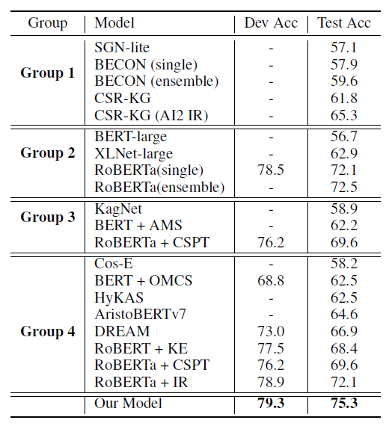
Experiments
Datasets
CommonsenseQA: (9,741/1,221/1,140)
Pre-trained Model: XLNet
Group 1: No description
Group 2: Pre-trained language model
Group 3: Pre-trained model + structural knowledge
Group 4: Pre-trained model + unstructured knowledge
Notes:
In the experiments, we utilize the CommonsenseQA dataset to verify our ideas. There are more than 9 thousand instances in the training set and about 1 thousand instances in the dev and test set.
In our model, we utilize XLNet as the pre-trained model and perform experiments.
The results are shown in the table, we can see that our model can get the best result on the dev and test dataset. We classify the methods into 4 categories from the leaderboard, including models with no description, models only use pre-trained language model and models which use structural or unstructured knowledge.
In the following slides, we will dive into our model and see the effects.

Slide 17
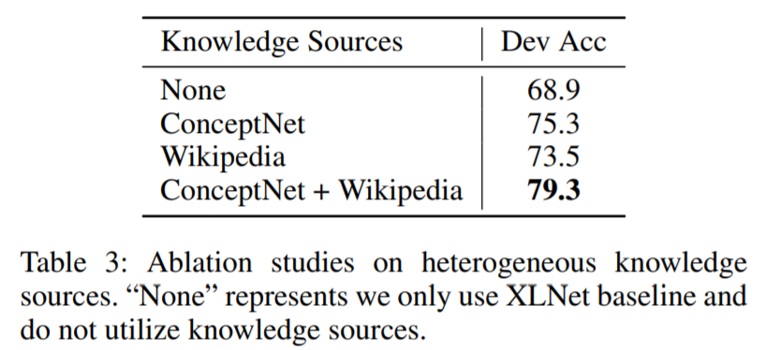
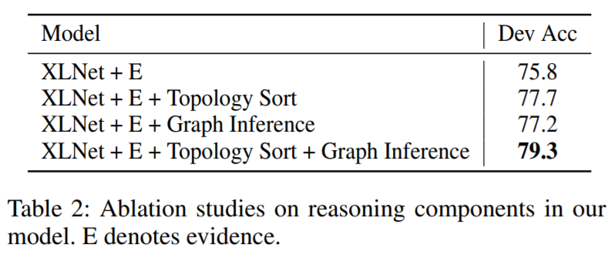
Ablation Study
Ablation Study on Knowledge Sources
Ablation Study on Reasoning Modules
Notes:
We perform ablation studies to see the effect of different knowledge sources and reasoning modules. We first perform experiments on knowledge sources, None represents we do not use any external knowledge. From the results, we can see that by adding each source, our model can get better results than the baseline. Combing both sources will lead to better results. The results verify the effectiveness of our motivation.
We then dive into two reasoning modules, namely, the topology sort algorithm and the graph inference module. From the results we can see that each reasoning module can lead to improvements and combing them will lead to better results.

Slide 18
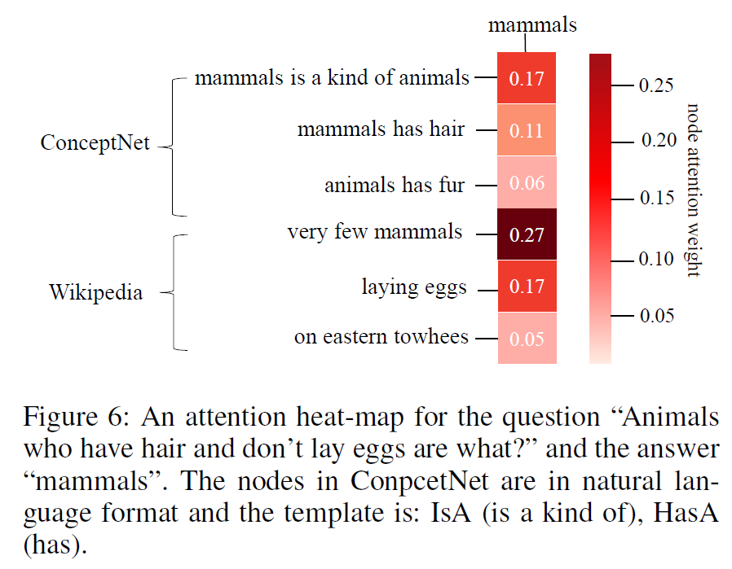
Case Study
Question: Animals who have hair and don’t lay eggs are what?
Right Answer: mammal
Notes:
We show a case to show how our model can get the right answer. The question is “Animals who have hair and don’t lay eggs are what?
” and the right answer is “mammal”. We obtain the attention and plot it in the figure. The first three nodes are from Concept-Graph and the last three nodes are from Wiki-Graph. We can see that our model gives higher attention to nodes like “mammals is a kind of animals”, “very few mammals”, “laying eggs”. By combining both evidence, our model can select the right answer.

Slide 19
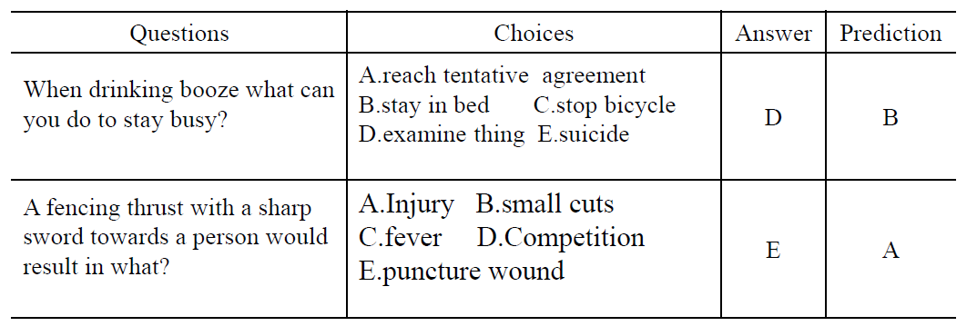
Error Analysis
We conduct error analysis on 50 error cases in the dev set
Lack of evidence (10)
Enough evidence but too similar to distinguish (38)
Dataset noise, 2 choices are the same (2)
Notes:
Then we give some error analysis on 50 error cases. We classify the errors into 3 categories. There are 10 instances which do not have enough evidence in the knowledge sources, the first line in the table is an example. The question and choice do not retrieve enough evidence from the sources and get the wrong answer.
There are 38 instances which have enough evidence but the evidence is too similar to distinguish since the choices are similar to each other. The second line in the table shows a case. The choices injury and wound are similar and it is hard to distinguish them. More evidence should be added to get the right answer.
Also, we observe some dataset noise, there are some instances which have the same two choices and it will mislead the model.

Slide 20
Conclusion
We propose an approach consisting of knowledge extraction and graph-based reasoning for commonsense question answering problems.
By selecting appropriate knowledge, our method can be applied to other commonsense tasks like CosmosQA, PhysicalIQA, SocialIQA, etc.
Notes:
Finally, we give the conclusion. We propose an approach consisting of knowledge extraction and graph-based reasoning for commonsenseqa question answering problems.
And we think our approach has a broader range of application. By selecting appropriate knowledge, our method can be applied to other commonsense tasks like CosmosQA, PhysicalIQA, SocialIQA, etc.

Slide 21
Any Question? Contact us:
lvshangwen@iie.ac.cn
guody5@mail2.sysu.edu.cn
jingjingxu@pku.edu.cn
Thank you！
Notes:
Thanks for your attention and time. If you have any questions, please contact us. Our emails are listed as follows, Thank you!

